Slide 1
Exercise 18
Vertebrate Histology

Slide 2
In this lab exercise, you observed the diversity of vertebrate tissues. You should know their names and the major tissue type to which they belong. Consult your lab manual for the role of each, the structures that you will need to recognize on each slide or model, and their functions. As in all exercises, concentrate on those structures in bold face type and those that you were asked to label on your diagrams.

Slide 3
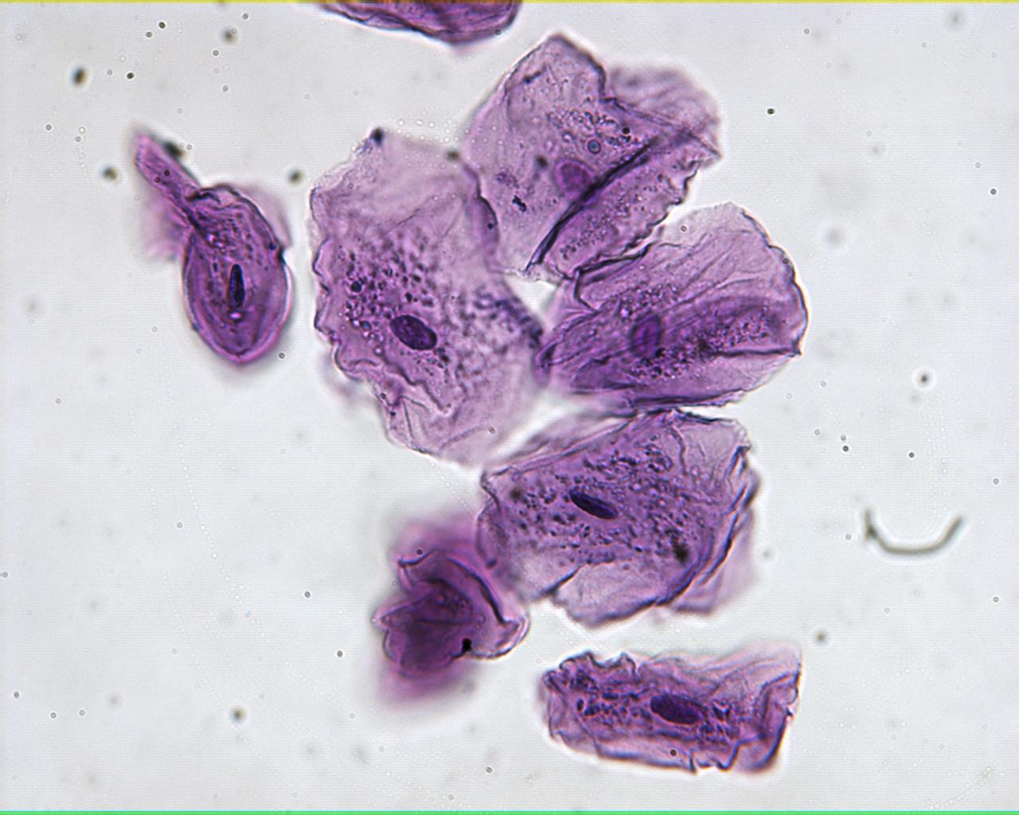
Cheek cells 400X

Slide 4
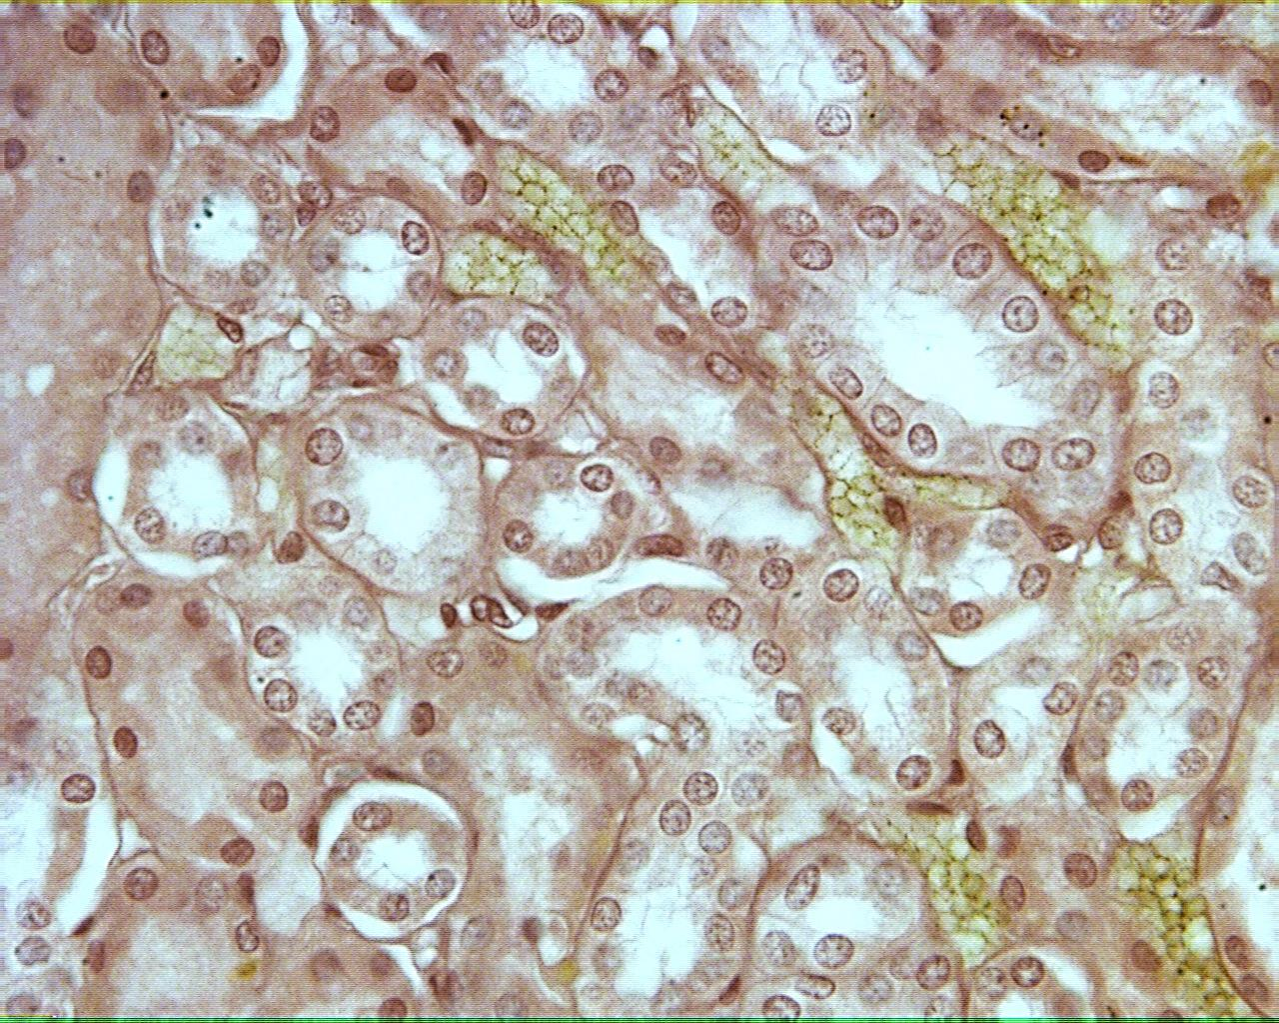
Kidney tubules 400X

Slide 5
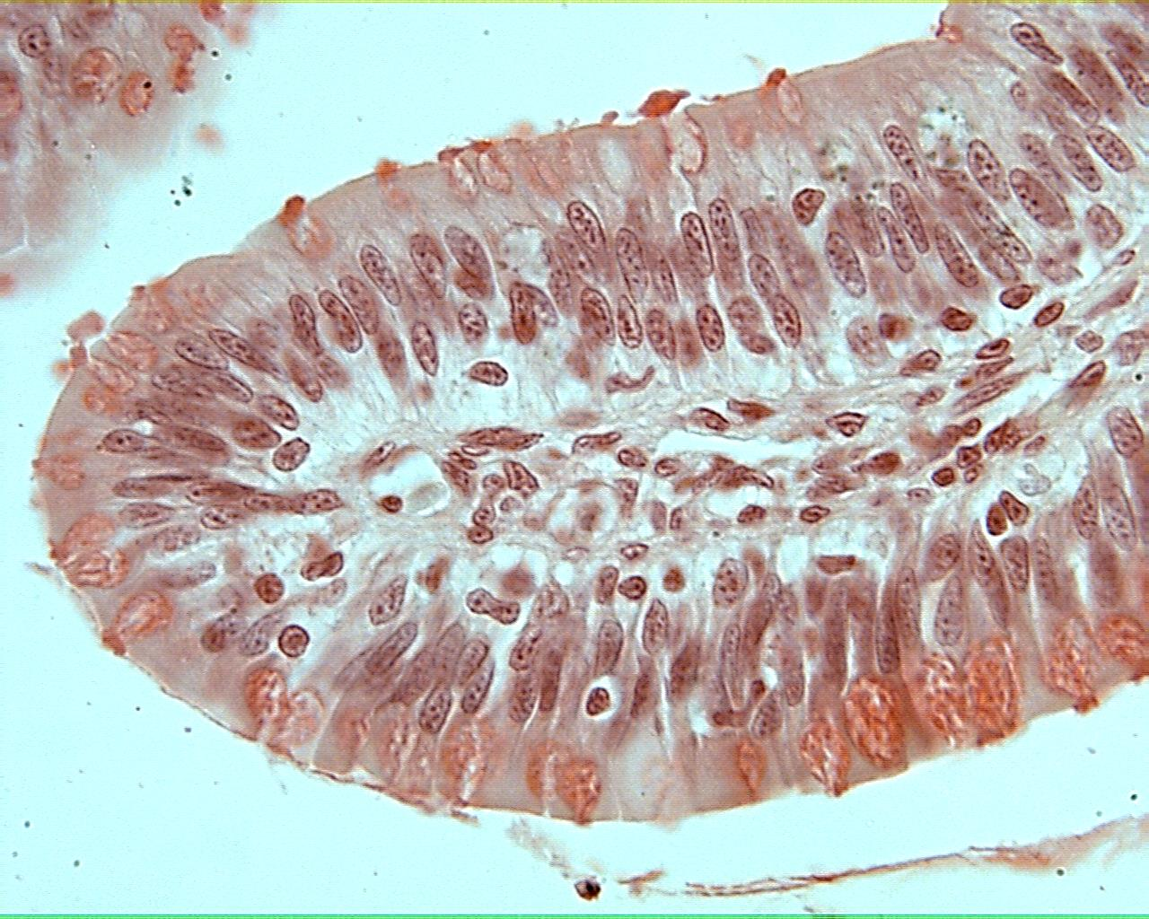
Frog intestine 400X

Slide 6
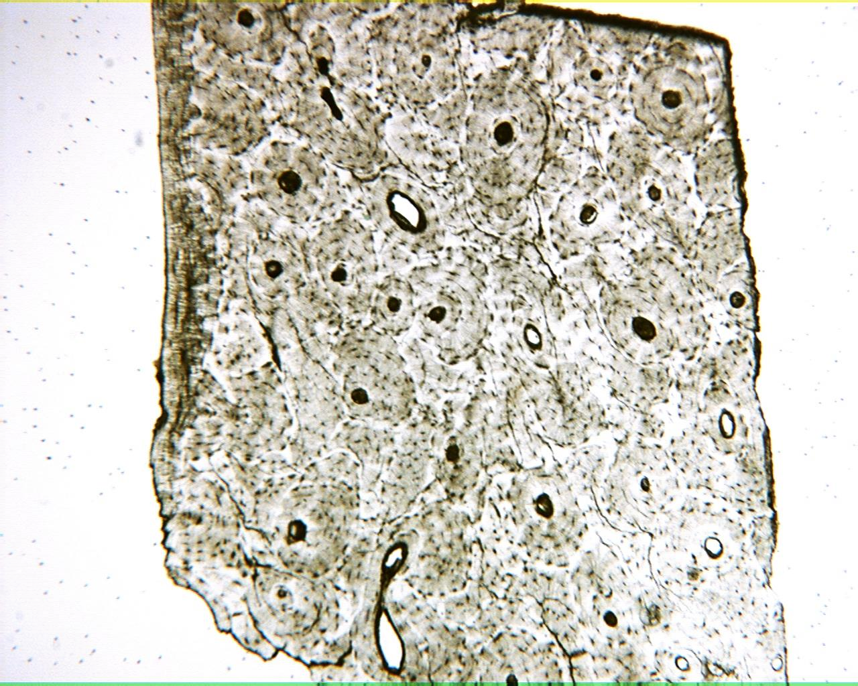
Bone 40X

Slide 7
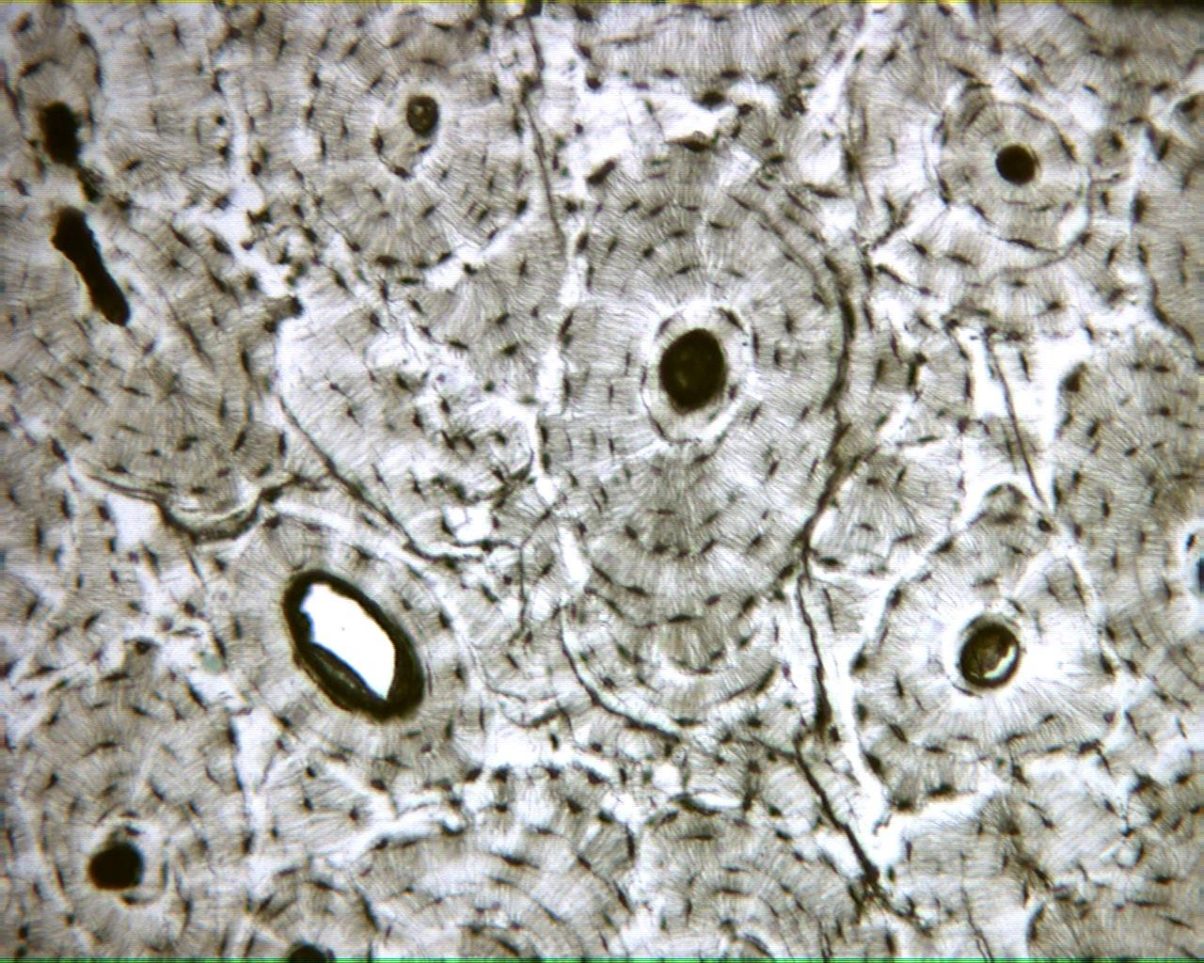
Bone 100X

Slide 8
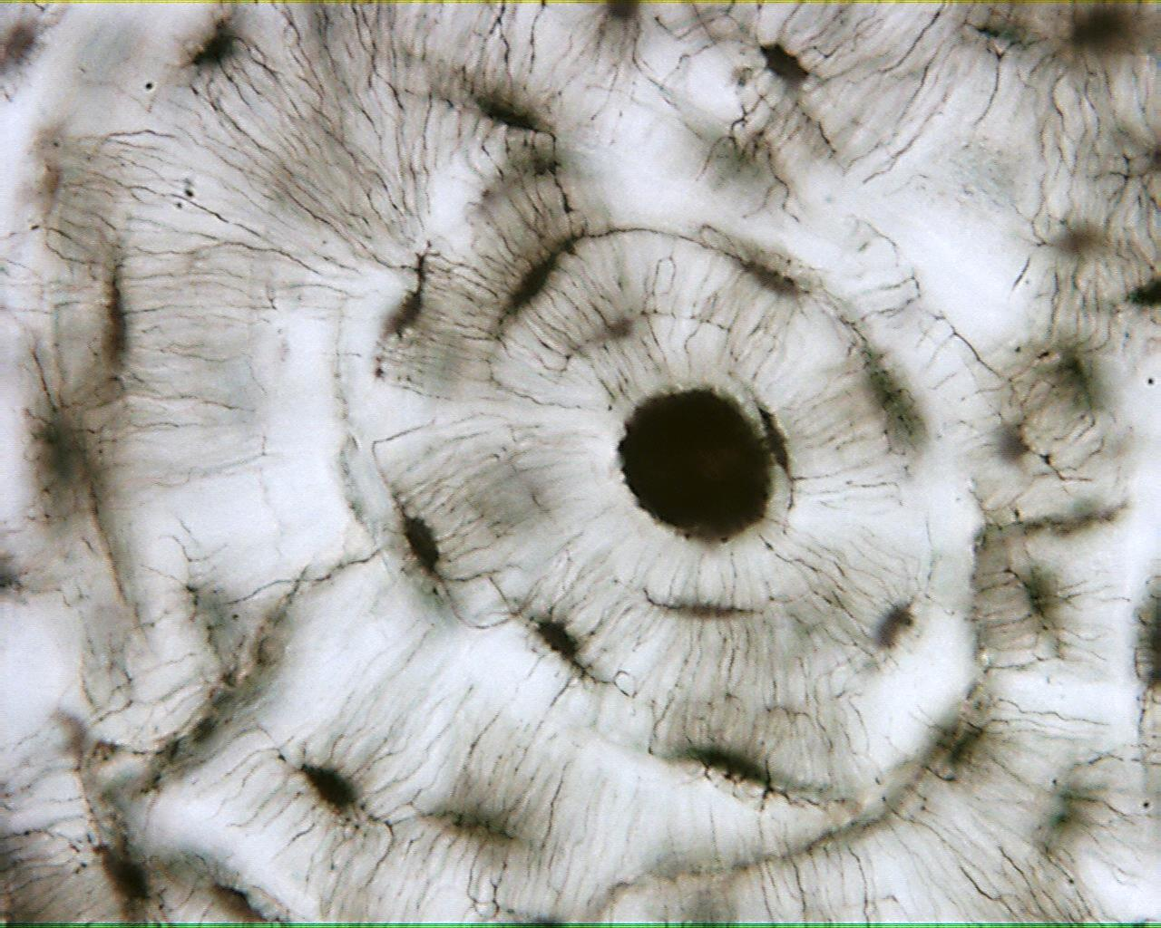
Bone 400X

Slide 9
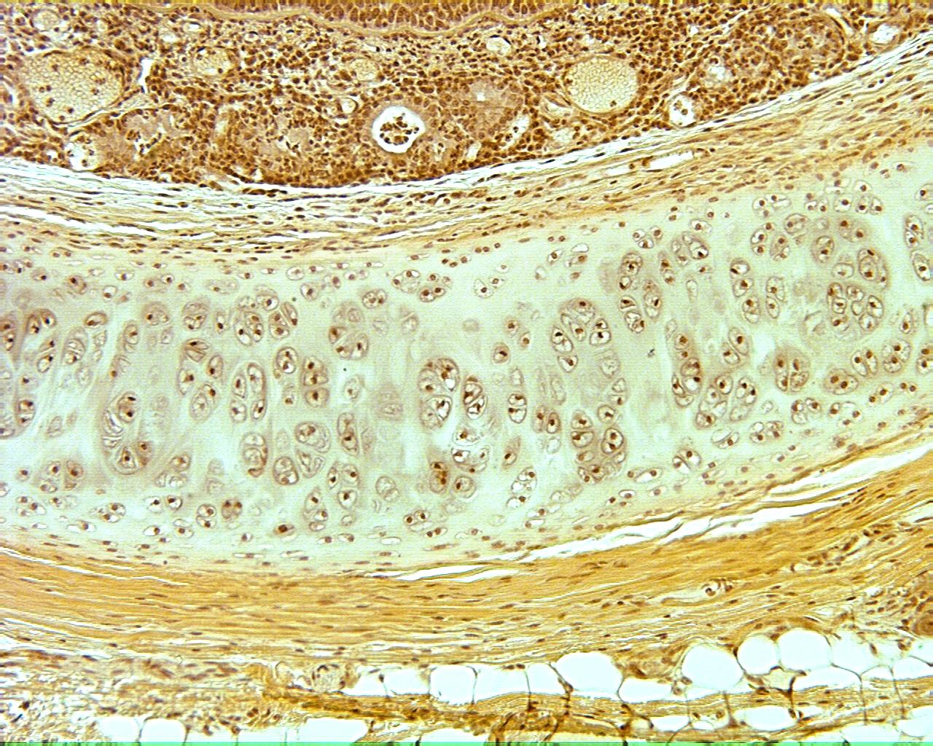
Cartilage 100X

Slide 10
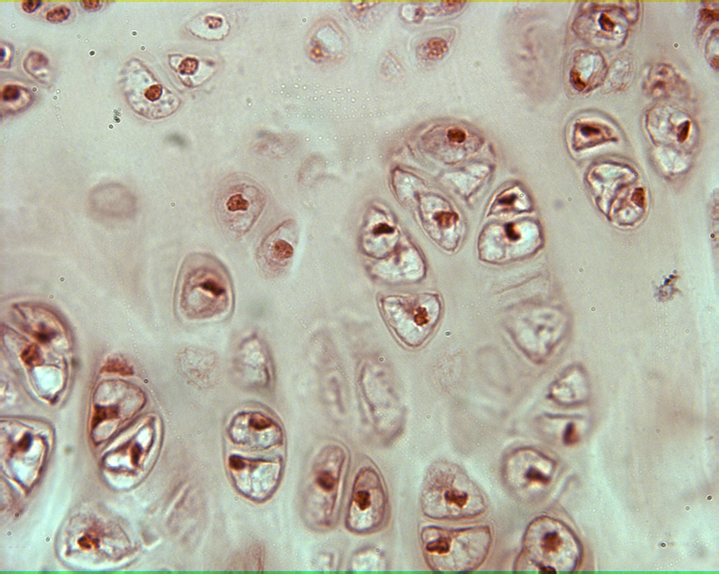
Cartilage 400X

Slide 11
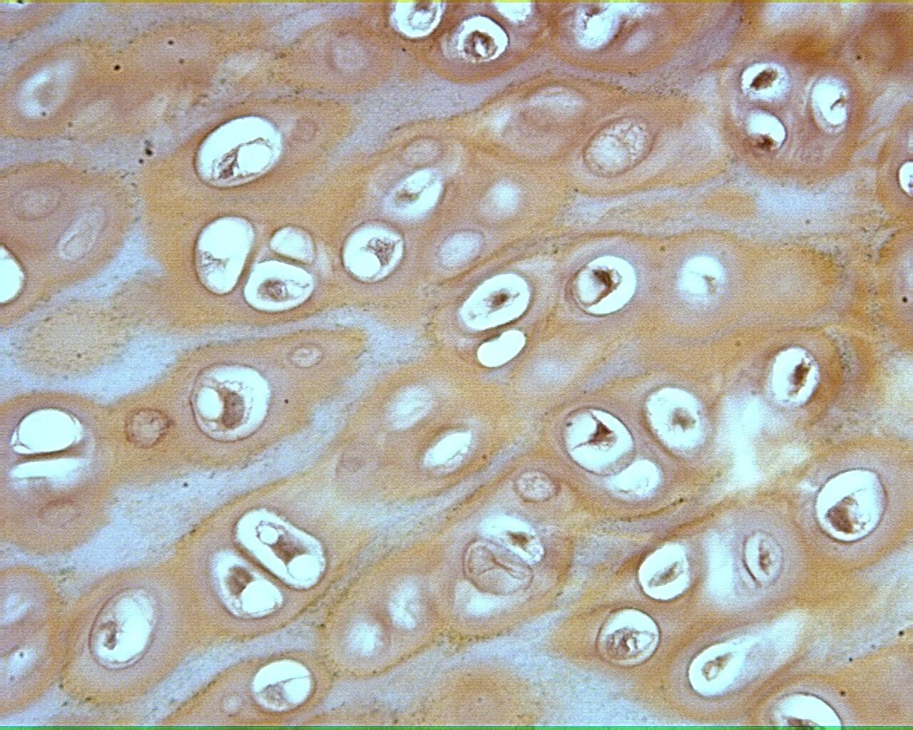
Cartilage 400X

Slide 12
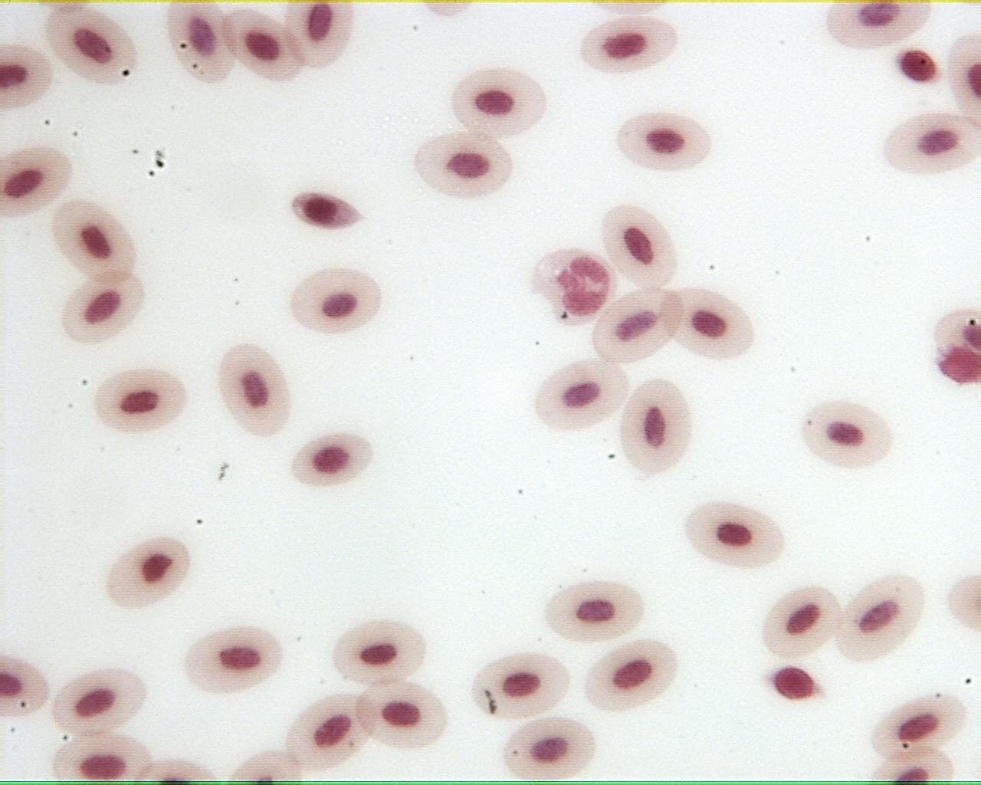
Frog blood 400X

Slide 13
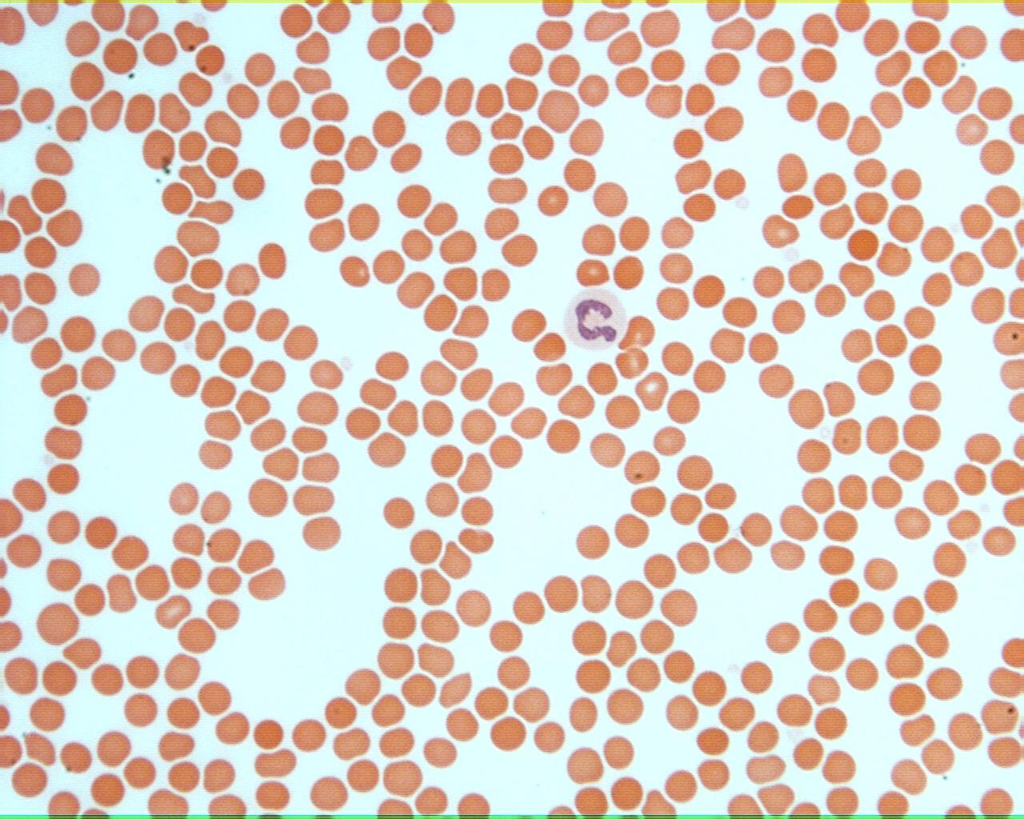
Human blood 400X

Slide 14
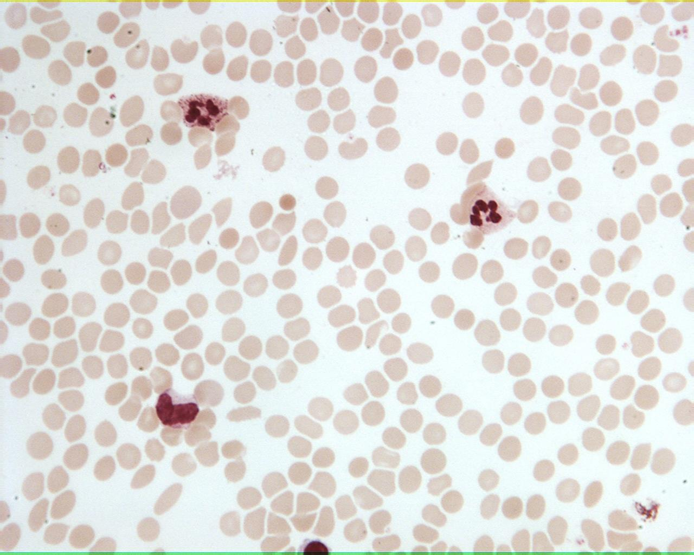
Human blood 400X

Slide 15
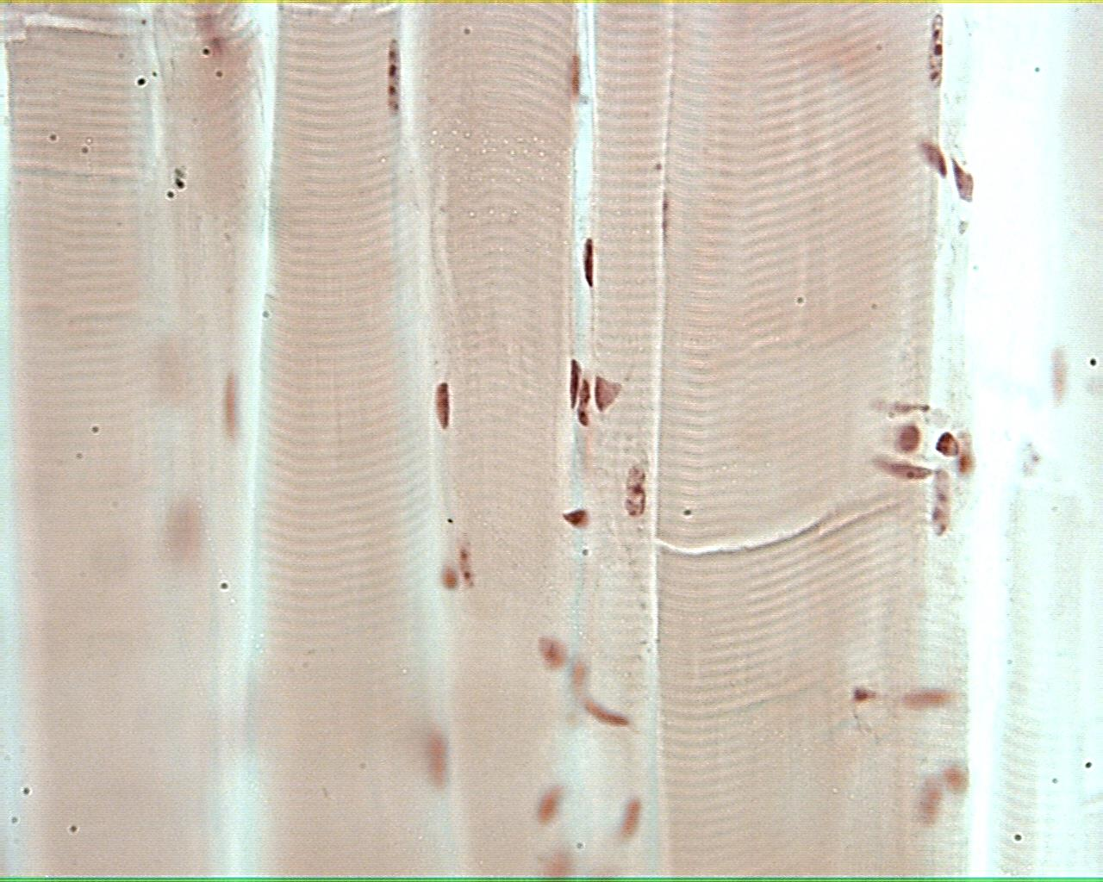
Skeletal muscle 400X

Slide 16
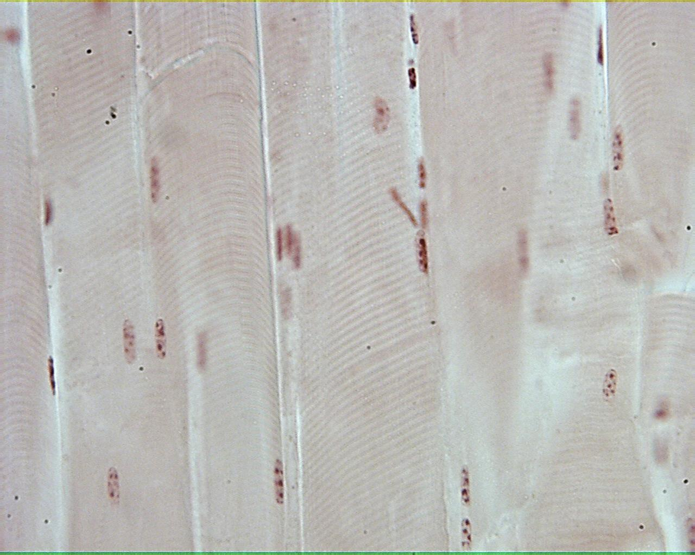
Skeletal muscle 400X

Slide 17
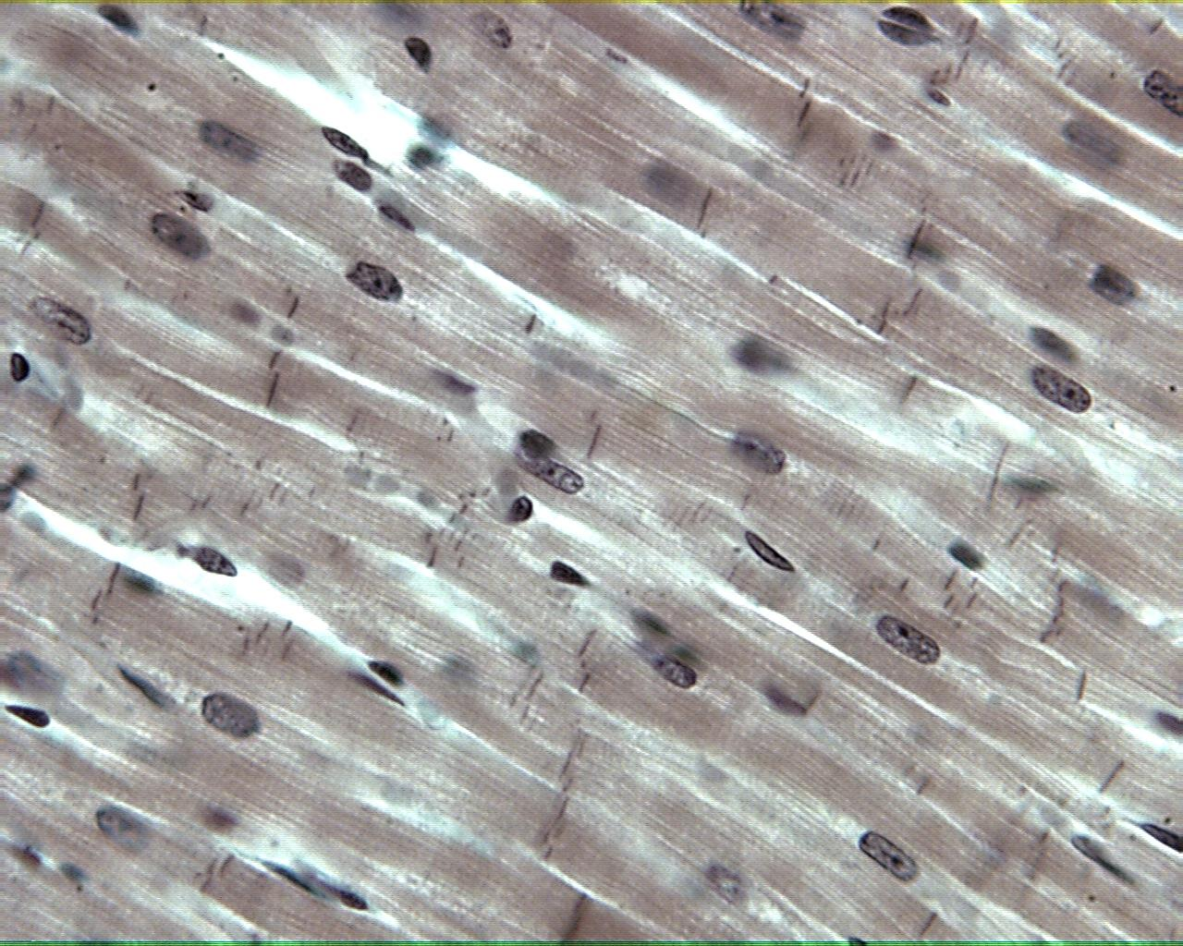
Cardiac muscle 400X

Slide 18
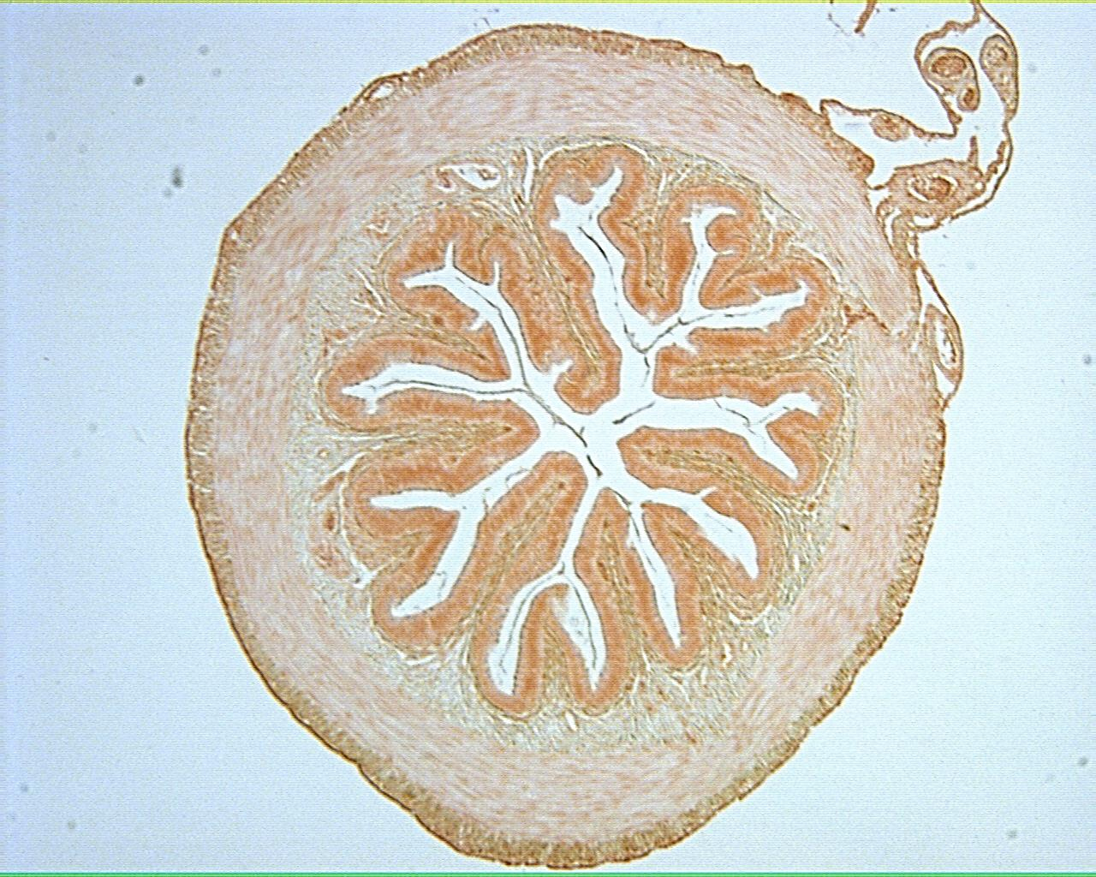
Frog intestine 40X

Slide 19
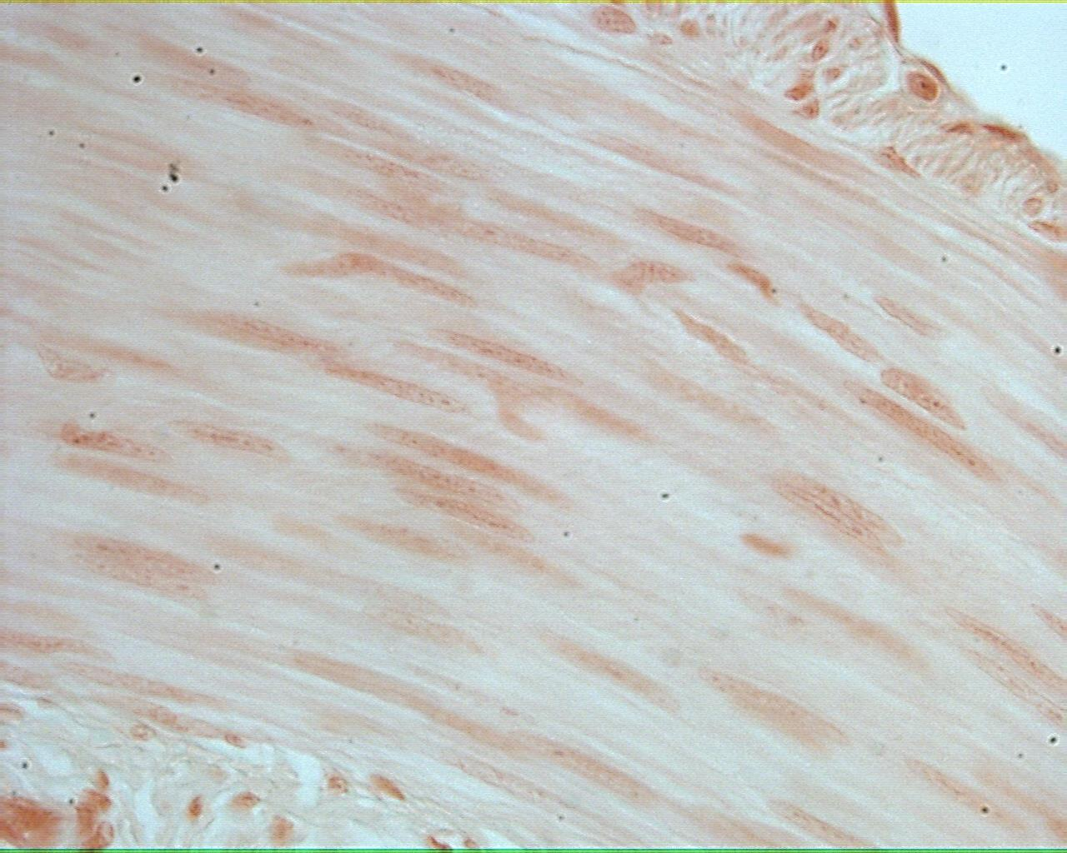
Smooth muscle 400X

Slide 20
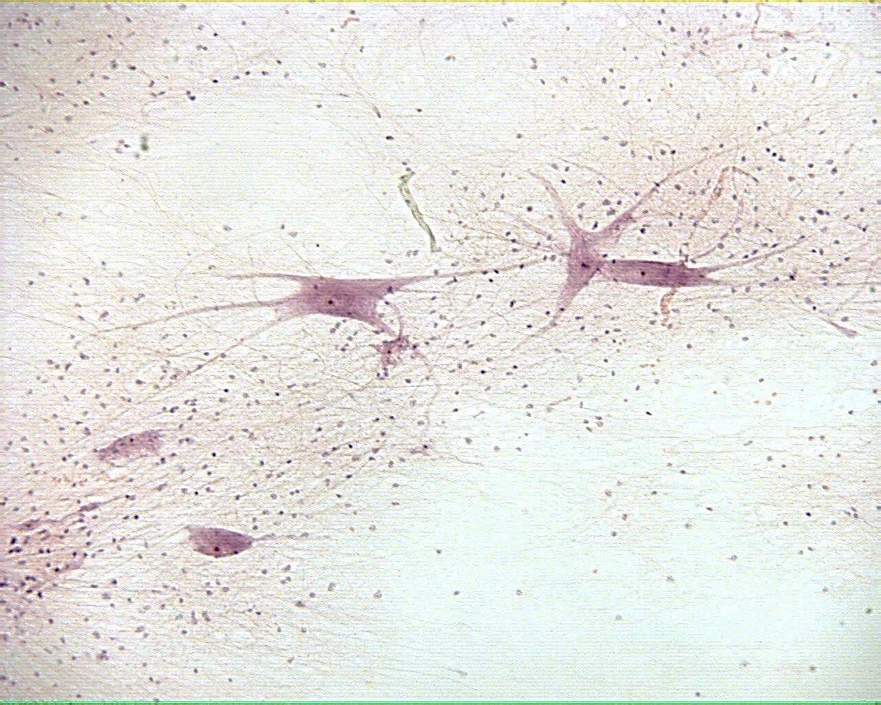
Nervous tissue 100X

Slide 21
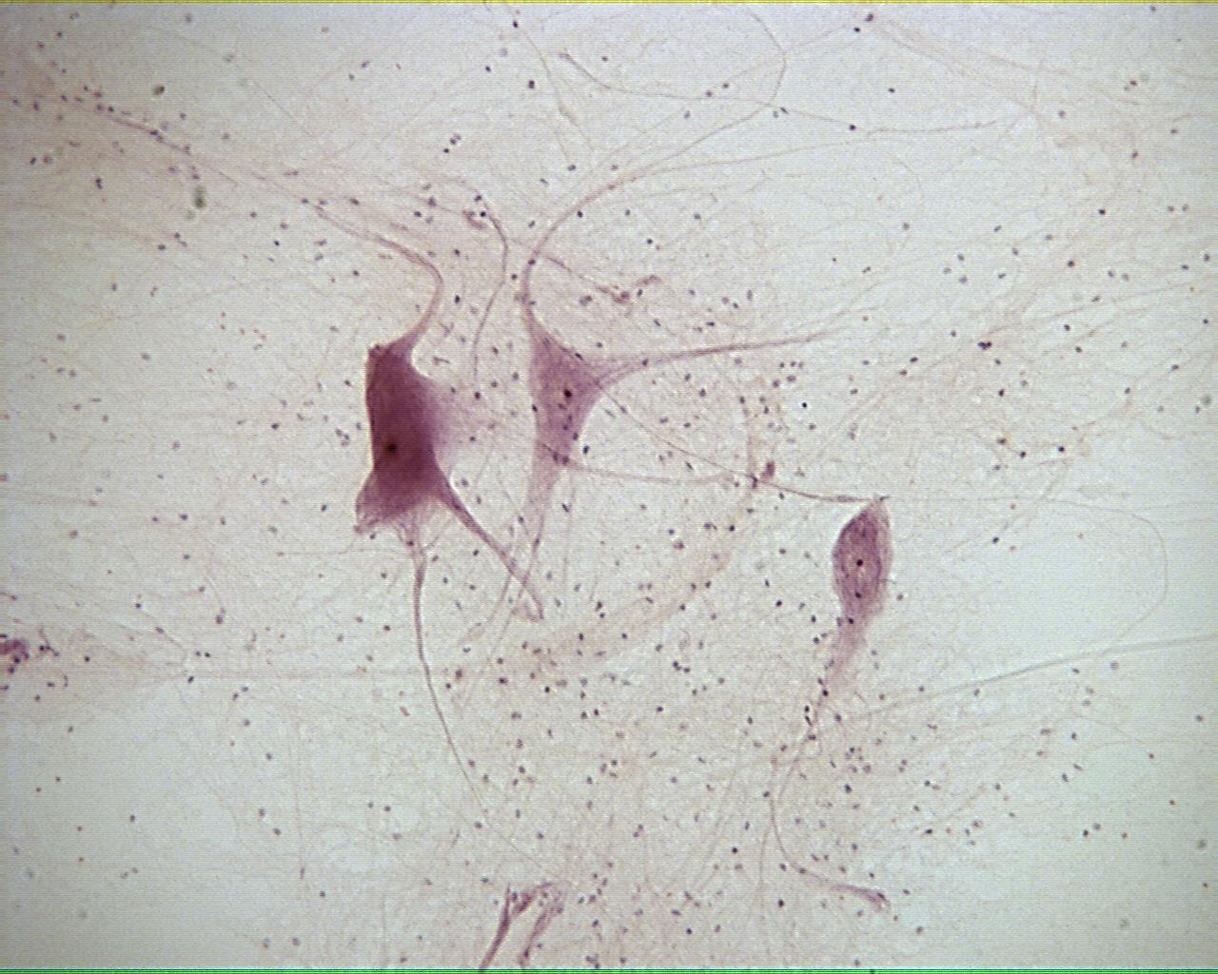
Nervous tissue 100X

Slide 22
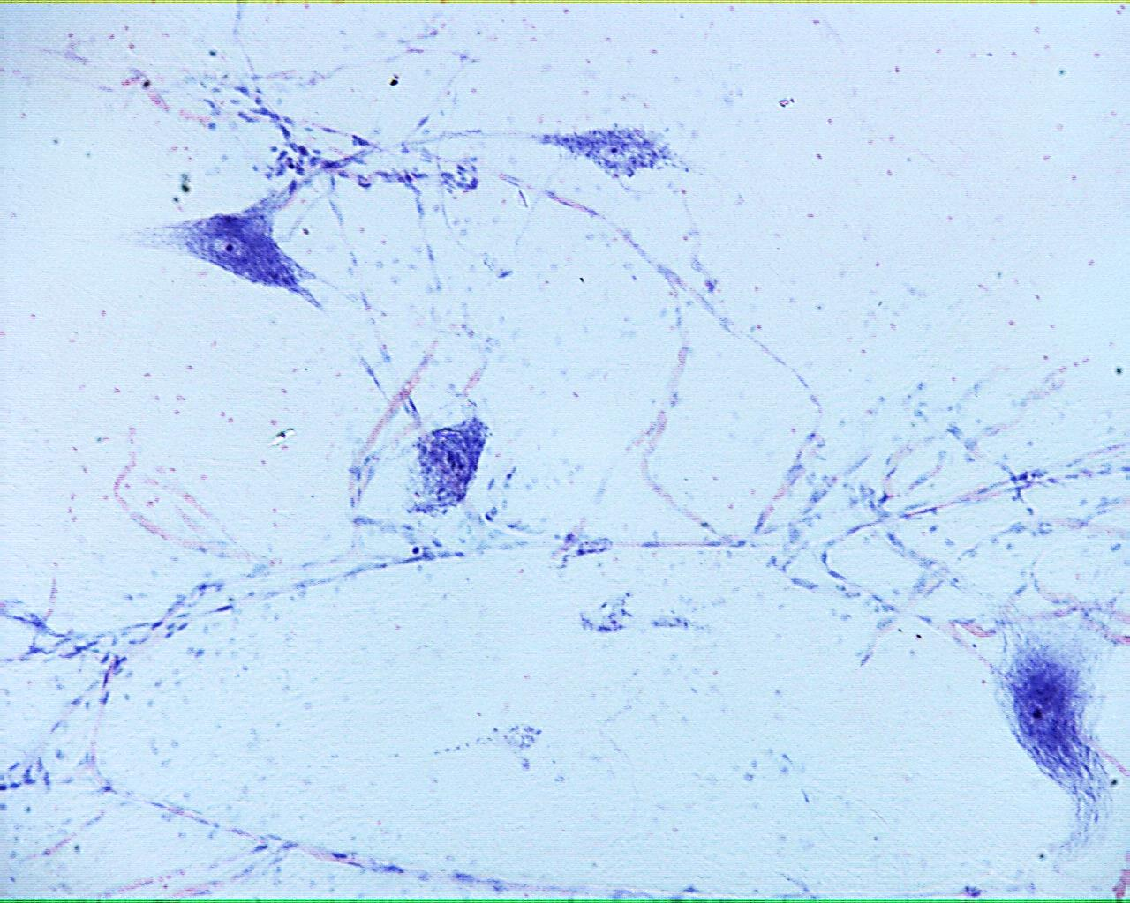
Nervous tissue 100X

Slide 23
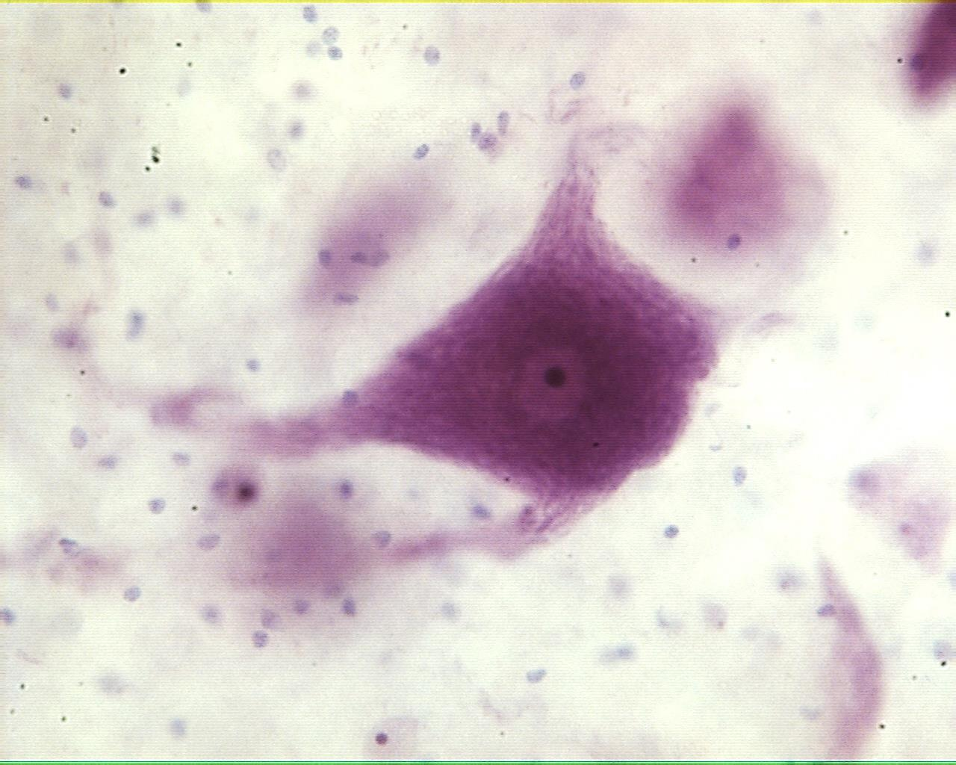
Nervous tissue 400X

Slide 24
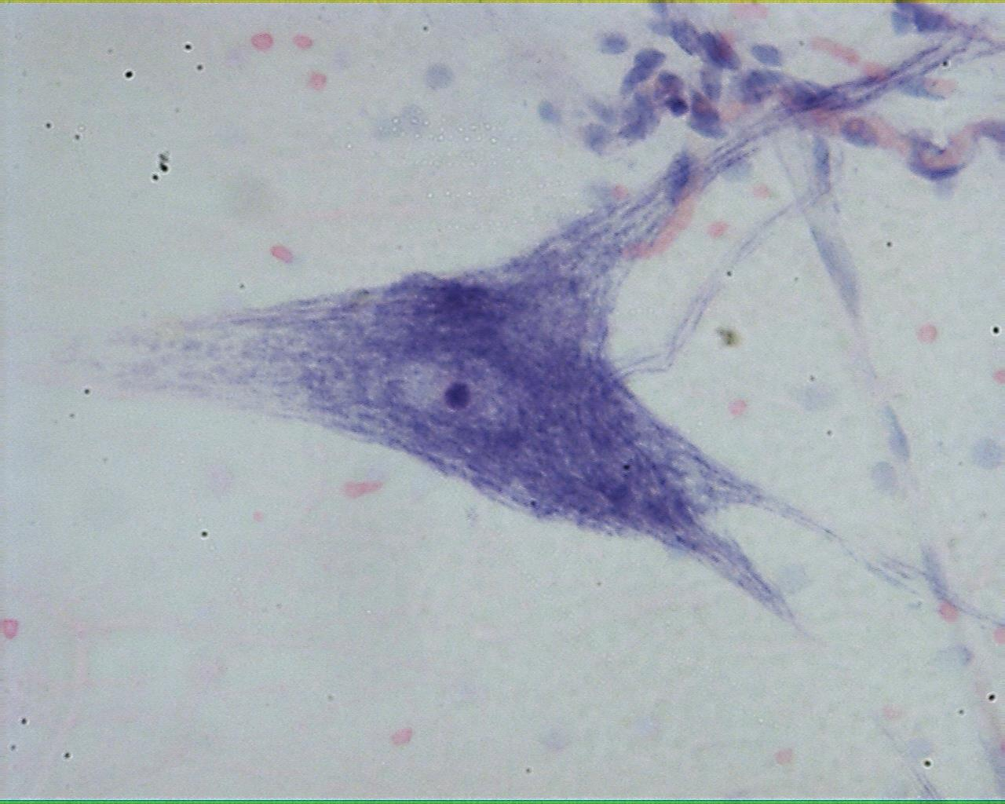
Nervous tissue 400X

Slide 25
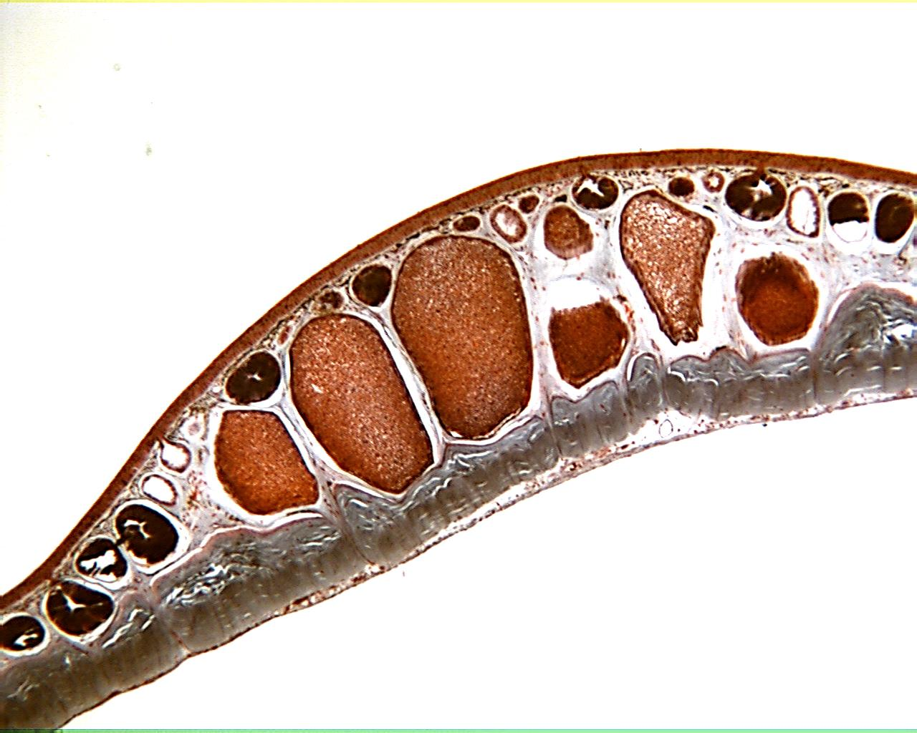
Frog skin 40X

Slide 26
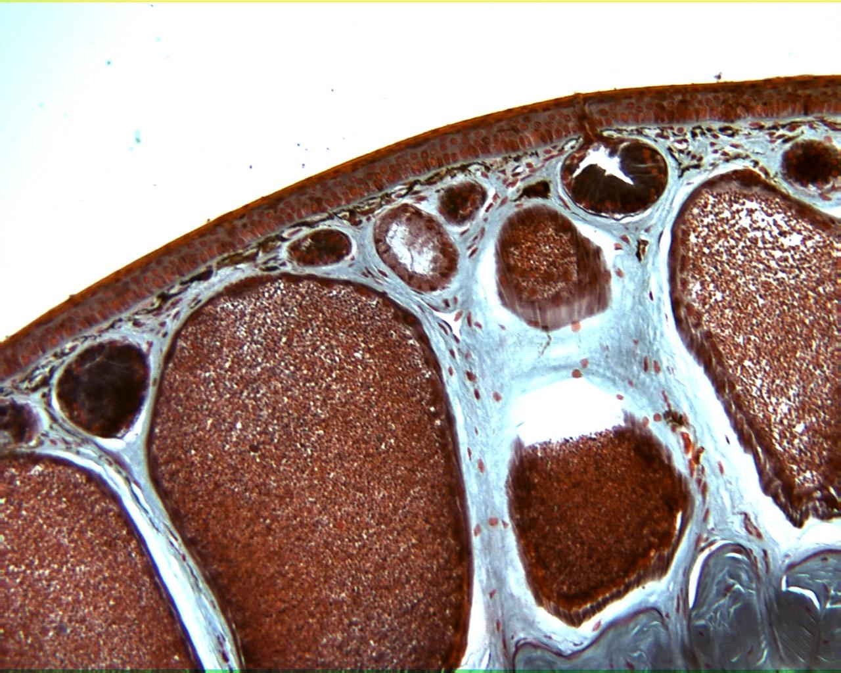
Frog skin 100X

Slide 27
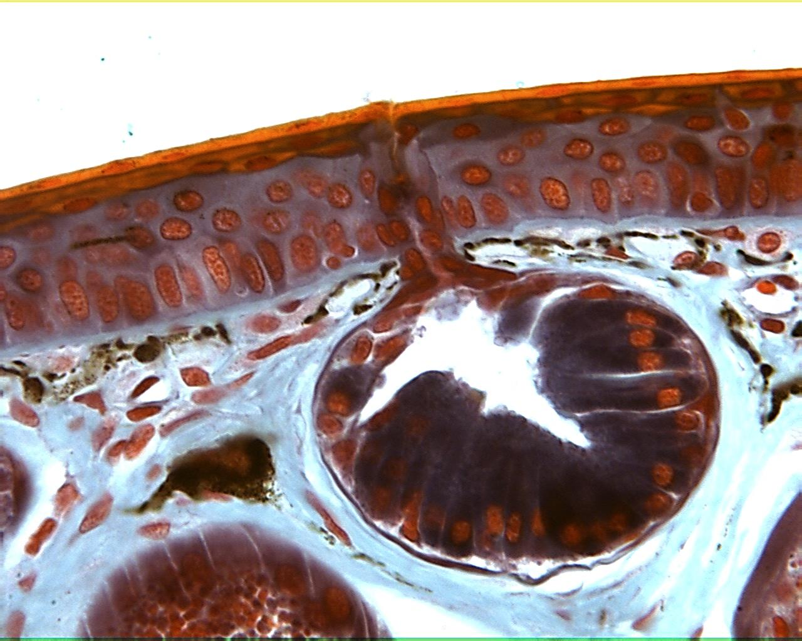
Frog skin 400X

Slide 28
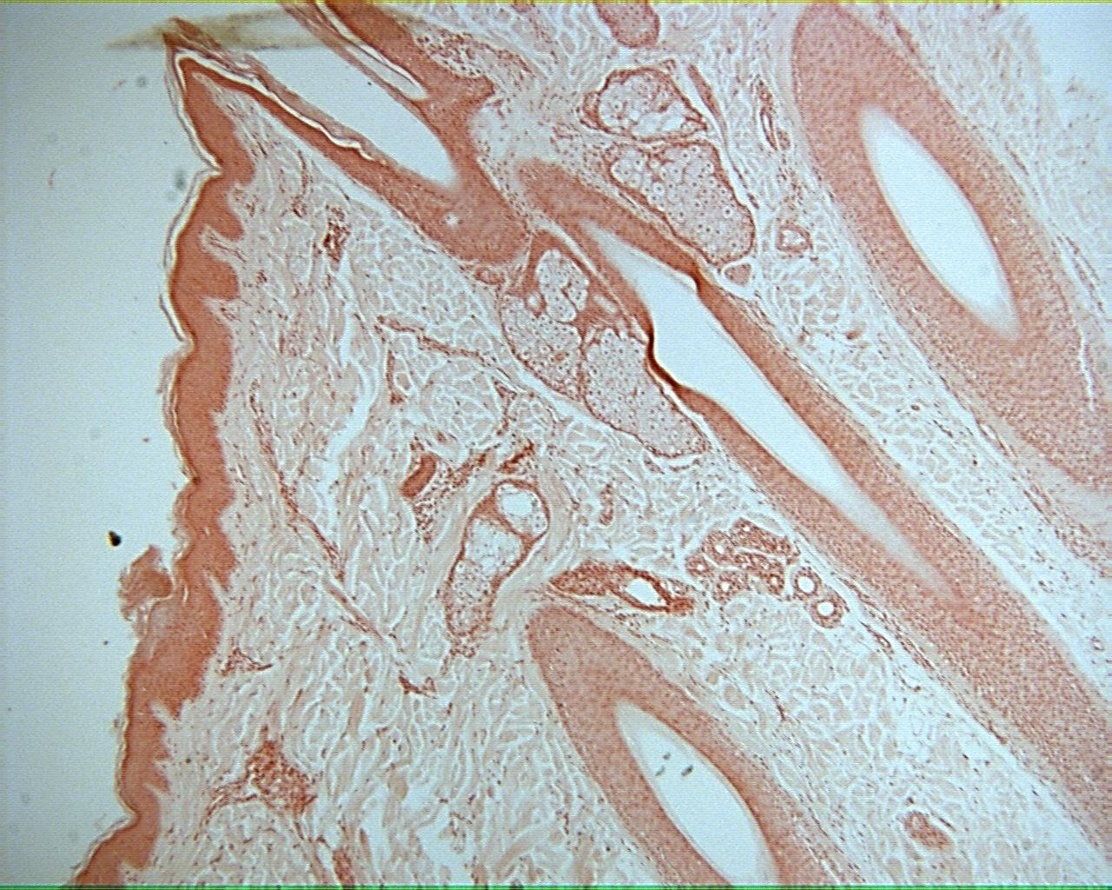
Human skin 40X

Slide 29
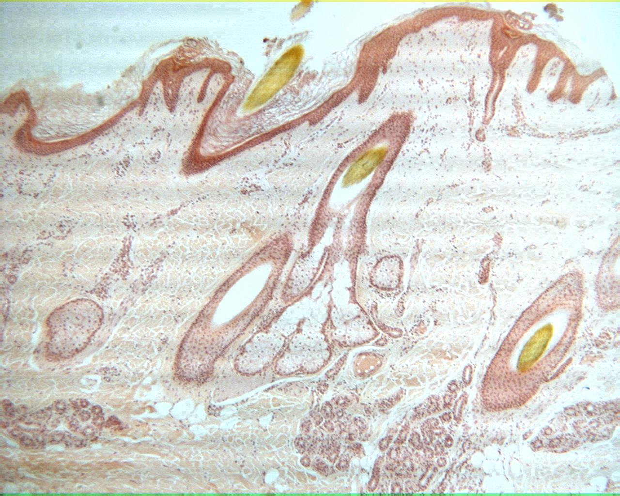
Human skin 40X

Slide 30
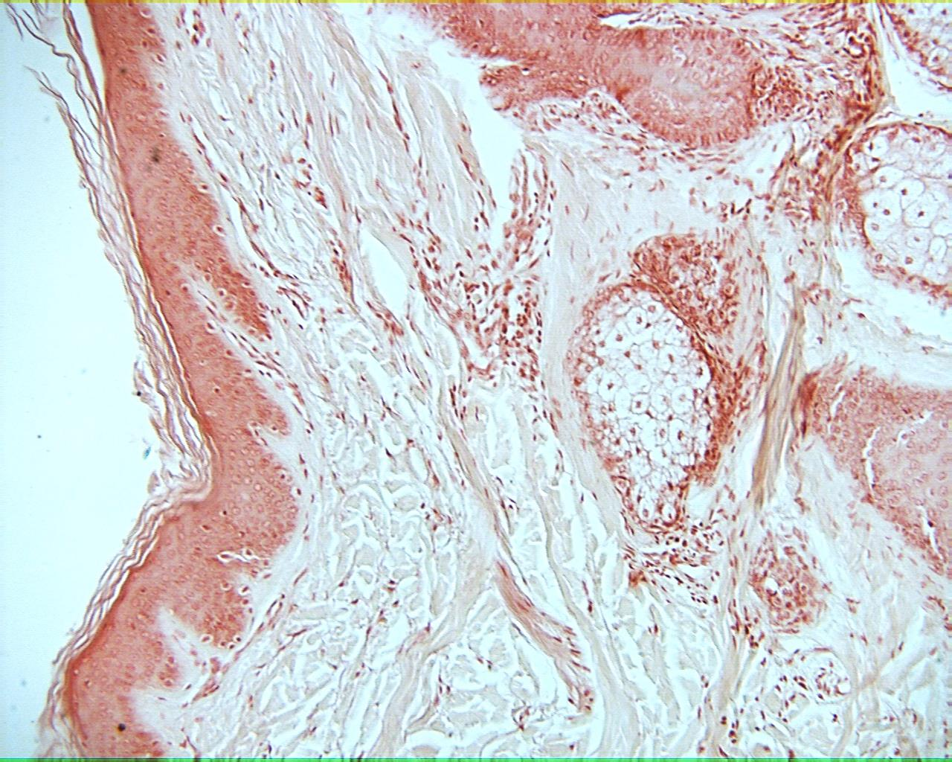
Human skin 100X

Slide 31
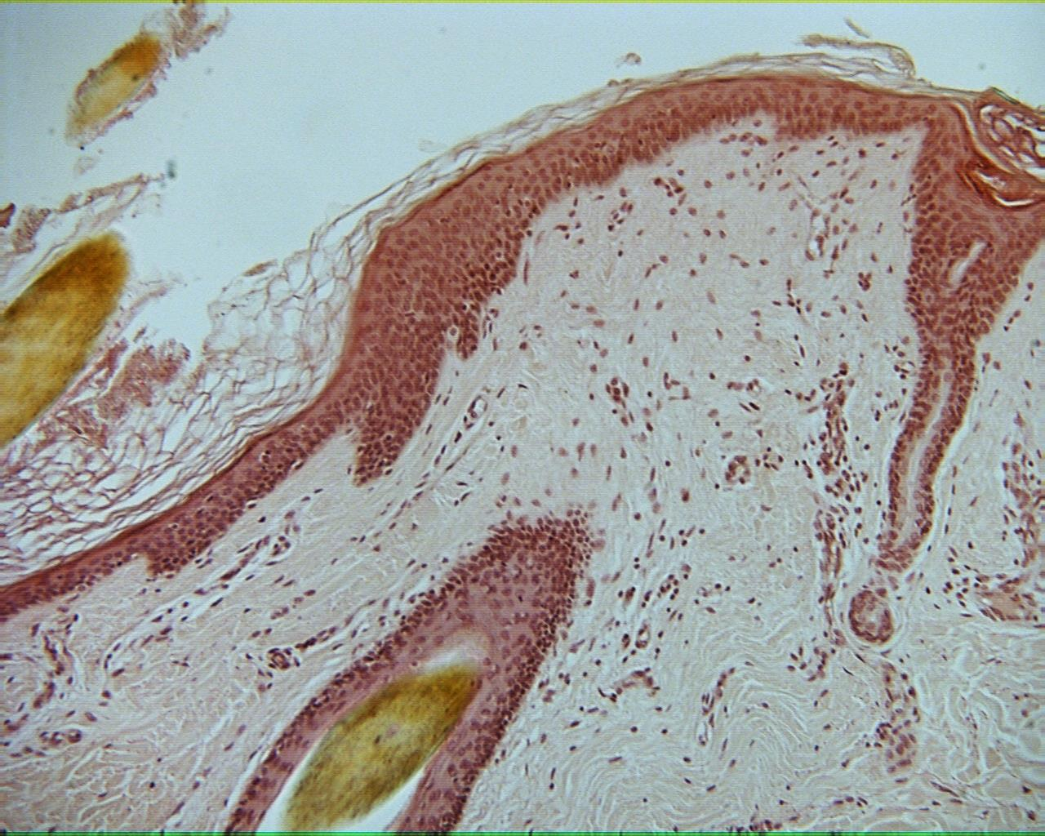
Human skin 100X

Slide 32
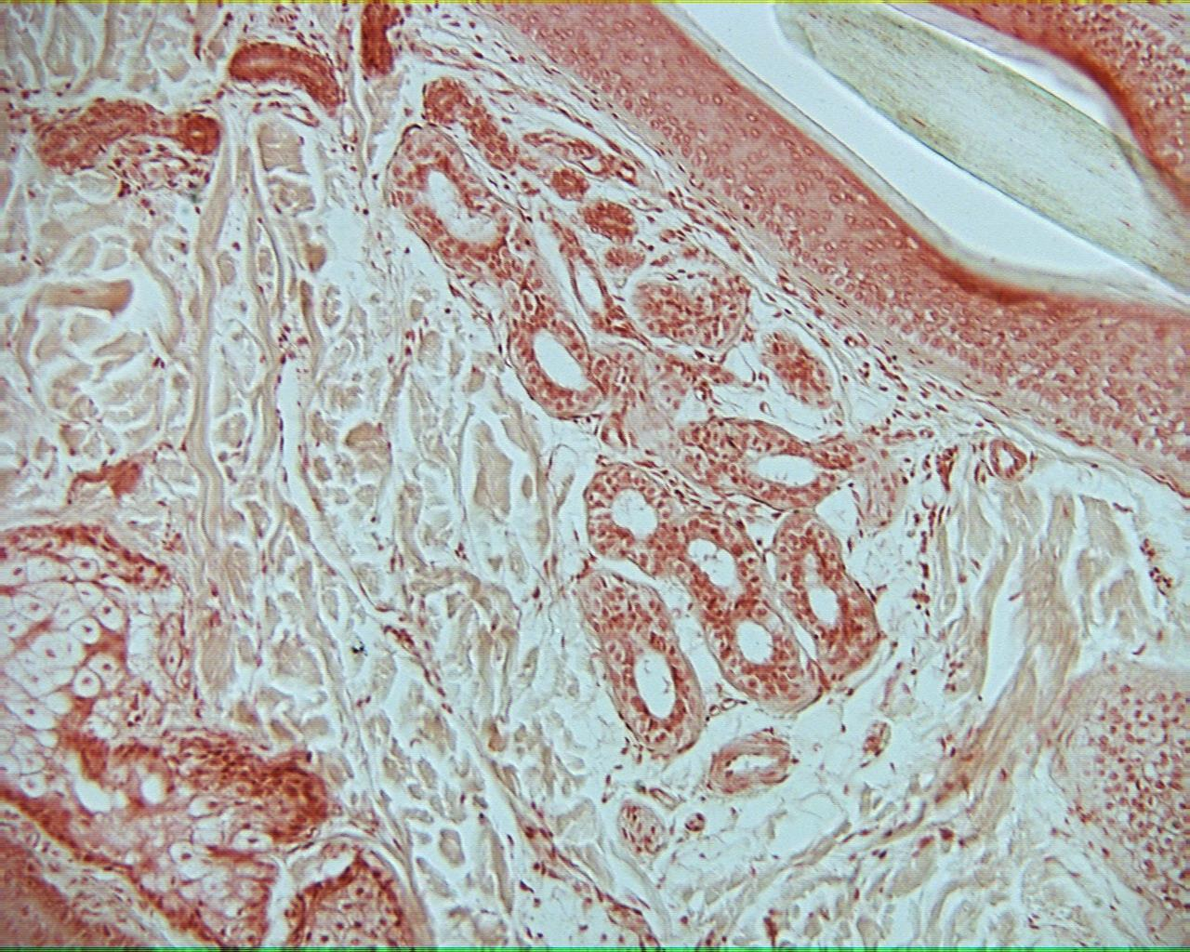
Human skin 100X

Slide 33
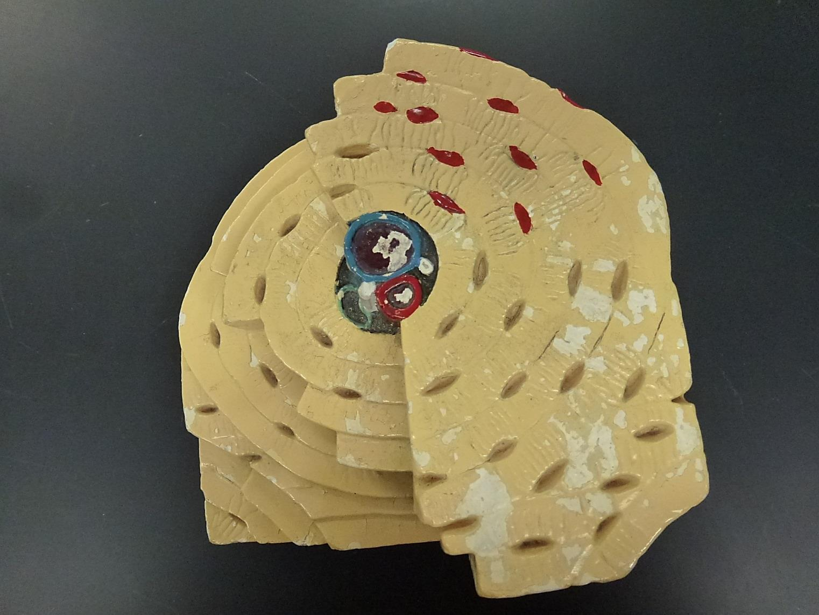
Bone Model

Slide 34
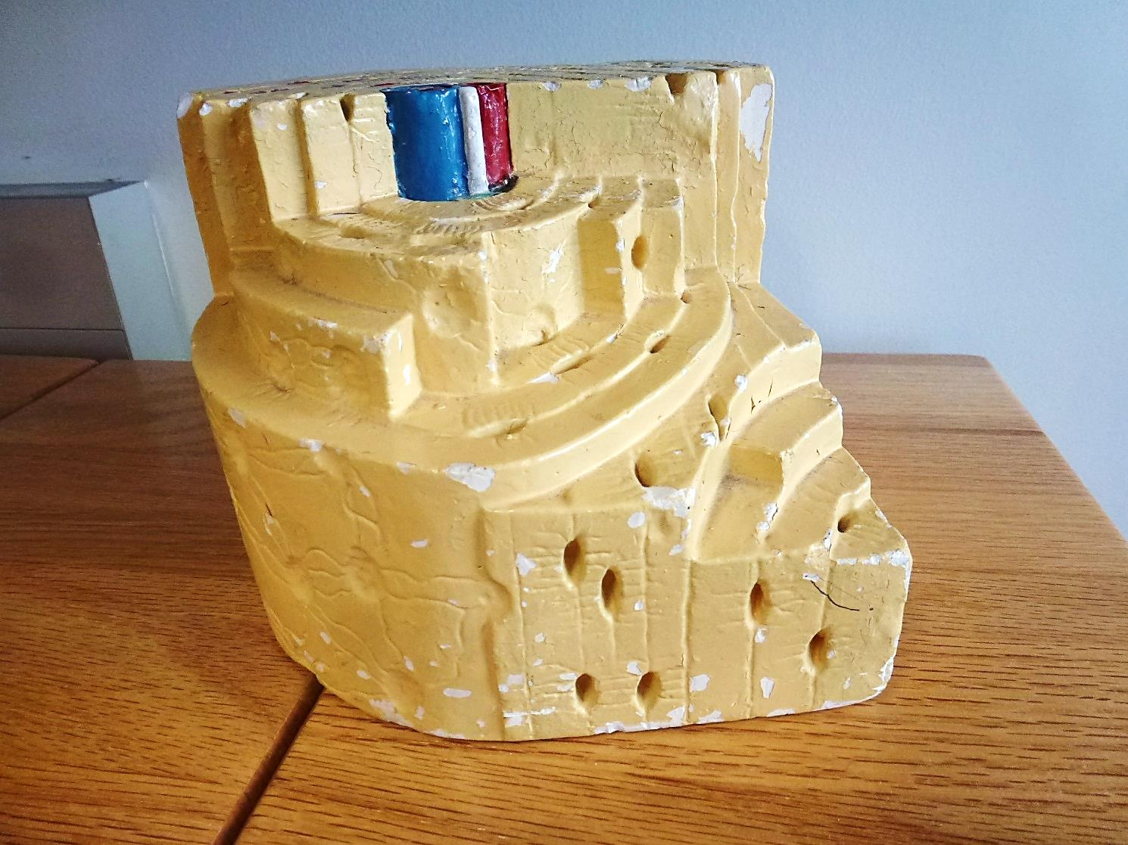
Bone Model

Slide 35
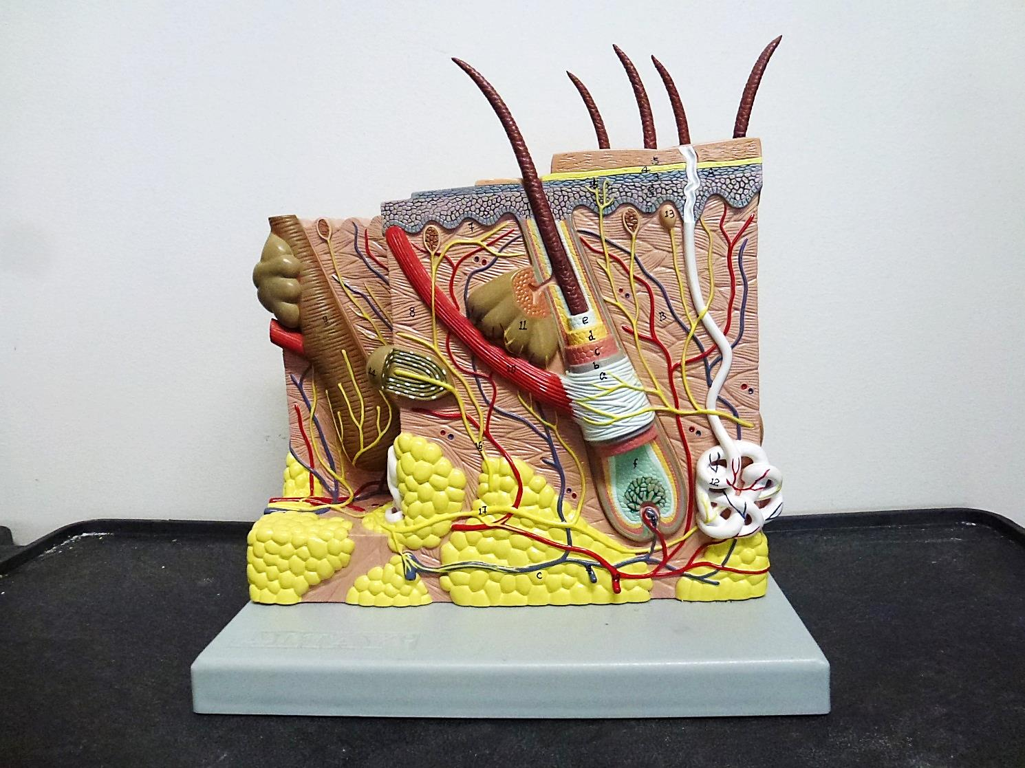
Human Skin Model

